Slide 1
What Keeps You Up At Night?
Solving Relocation Nightmares!

Slide 2
Nightmare Solution’s Team
Marianne Wong, Electronic Arts
Rebecca Counihan, Intuitive Surgical
Sandy Beyer, SalesForce
Patty Ginochio, Cartus

Slide 3
Session Goals
Mobility Challenges Overview
EA, Intuitive Surgical and SalesForce present their challenges
Break out into teams to solve theirs and some new ones
Come back together, present ideas
Present winners!

Slide 5
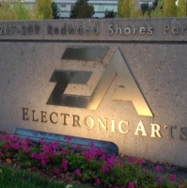
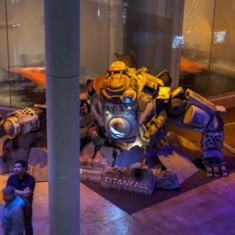
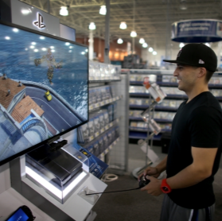
ELECTRONIC ARTS
300 MILLION REGISTERED PLAYERS
IN OVER 200 COUNTRIES
FOUNDED IN 1982
FY15 REVENUE $4.5 BILLION
GAMES, CONTENT AND LIVE SERVICES ON CONSOLE, PC, MOBILE AND TABLET
#1 PUBLISHER ON PLAYSTATION4 AND XBOX ONE CONSOLES IN THE WESTERN WORLD
OVER 2 BILLION DOWNLOADS OF EA MOBILE GAMES

Slide 6
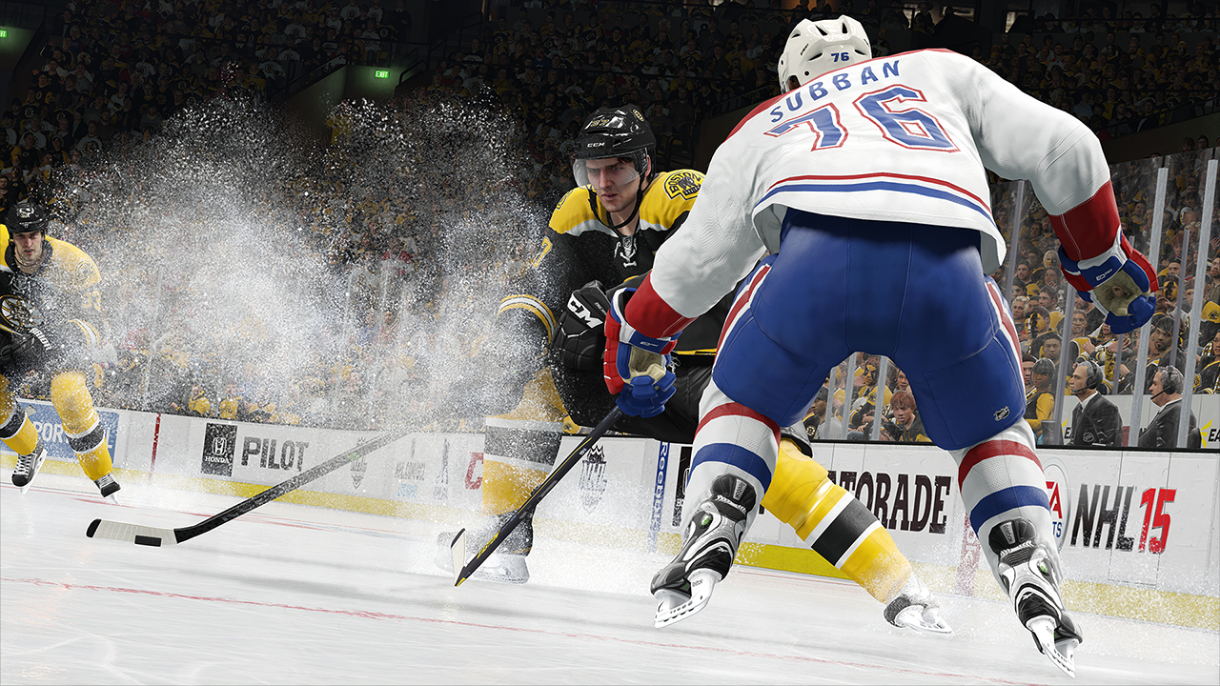
Electronic Arts
VISION
WE UNITE THE WORLD THROUGH PLAY

Slide 7
Electronic Arts
MISSION
BUILD THE WORLD’S BEST DIGITAL PLAYGROUND WITH FUN FOR EVERYONE, ANYTIME, ANYWHERE
Notes:
At EA our mission is simple – to deliver the best experience to our consumers everywhere they want to play.

Slide 8
Electronic Arts
GLOBAL REACH
Helsinki
Stockholm
Gothenburg
Edmonton
Macclesfield
London
Vancouver
Montreal
Cologne
Seattle
Kitchener
Charlottetown
Guildford
Bucharest
Sacramento
Lyon
Seoul
Geneva
Beijing
San Francisco
Salt Lake City
Madrid
Redwood Shores (HQ)
Baton Rouge
Tokyo
Los Angeles
Austin
Tiburon (Orlando)
Shanghai
Hyderabad
Singapore
Sydney
31
OFFICES
>25
LANGUAGES
>1,200
SKUS PUBLISHED
Non-development location
Melbourne
Development location
Notes:
We have a team that spans the globe to deliver our titles to everyone around the world.

Slide 9
Electronic Arts
GAMING’S BIGGEST BRANDS
Notes:
Take a look at just some of the IP we develop. These are brands that others in the business would look at with envy – we have a wide bench of great brands and continue to develop more.

Slide 10
What Keeps EA Up at Night? Issue #1: Noise
Seek out feedback through 1:1 discussions with employees to understand area of improvement
Develop creative solutions & increase support & benefits
Set expectations upon relo initiation
Listen to business partners to understand needs & issues
Prioritize employee experience by reviewing policies & processes
Continuous process improvements & partnering with vendors

Slide 11
What Keeps EA Up at Night? Issue #2: Being viewed as a Support vs. Strategic Function
More face time with key business leaders to understand business needs
Change the way we work with our HRBPs
Marketing accomplishments to partners

Slide 12
Intuitive Surgical
https://www.youtube.com/watch?v=0XdC1HUp-rU

Slide 13
What keeps me up at night?
Talent Acquisition
Customized relocations (U.S. Domestic)
Every case is a one-off (International)

Slide 14
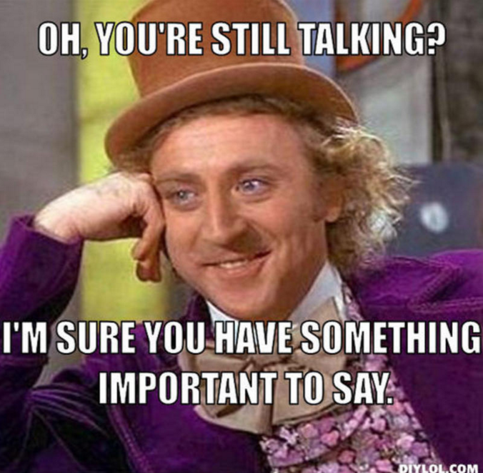
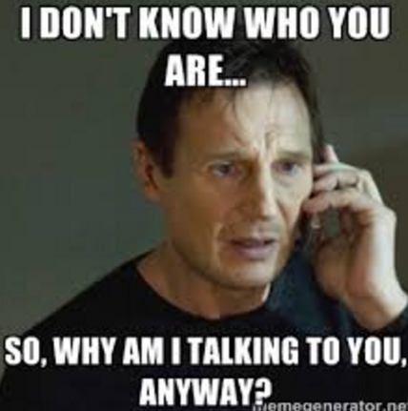

Slide 15
What keeps me up at night? Continued…
Trailing Liabilities / Taxation on Equity
Managing expectations
System limitations / Manual calculations

Slide 16
Keeping Me Awake!
Lack of Engagement
Just how do you interact with various stakeholders?
Business Partner
Manager
Recruiter
Employee
Consultation
Building Trust
Keeping Stakeholders engaged!

Slide 17
“Up at Night” Challenges Discussion
Break out into huddle groups of say 10 or so!
Room Assistants or you choose a Speaker and Group Leader
Provide Pen & Paper to Speaker to take notes
Group “huddles” together to do a speed session discussion
Huddle for 15 minutes discussing challenge
Then Group Speaker to provide brief summary to session attendees
Panel Huddle quickly, choose best solution discussion! Awards presented!
Challenges:
Noise
Being viewed as a Support vs. Strategic Function
Talent Acquisition
Customized relocations (U.S. Domestic)
Every case is a one-off (International)
Trailing Liabilities / Taxation on Equity
Managing expectations
System limitations / Manual calculations
Lack of Engagement

Slide 18
Thank you for letting us help you sleep tonight!

